Slide 1
Fake Reviews Detection using Supervised Machine
Learning
Team 11
19241004
Sarah Zabeen
Faculty
Annajiat Alim Rasel
ST & RA
Md. Farhadul Islam
Md Sabbir Hossain
By:
Ahmed M. Elmogy, Usman Tariq, Ammar Mohammed, Atef Ibrahim

Slide 2
Introduction
Fake reviews posted online to boost sales
Machine Learning approach to detect fake reviews
Feature extraction and behaviour analysis
Yelp dataset on restaurant reviews
K-Nearest Neighbour (KNN), Naive Bayes (NB), Support Vector Machine (SVM), Logistic Regression, Random forest

Slide 3
Why & How to detect
Online reviews are meant to be authentic feedback
Fake reviews contaminate the reliability of online reviews
Creates lack of trust for online services
Using machine learning, fake reviews could be detected
Content mining, opinion mining
Building features based on text and natural language processing.
Observing other patterns to detect fake reviews

Slide 4
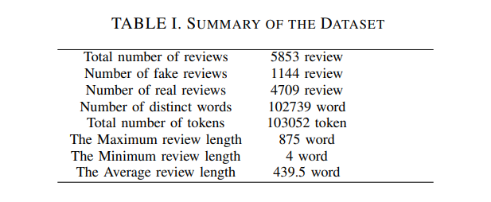
Dataset

Slide 5
Methodology I :
Dataset preprocessing (Tokenization, Stop Word Cleaning, Lemmatization)
Feature Extraction
TF-IDF
Bi-gram & tri-gram model
Feature Engineering
Cap-count
Punct-count
Emoji-behaviour
Group-by function

Slide 6
Methodology II:
Evaluation Metrics used:
Accuracy
Precision
Recall
F1-score
Ratio of Training : Testing = 70:30
Classification is done twice
In presence of extracted user behaviour data
In absence of extracted user behaviour data

Slide 7
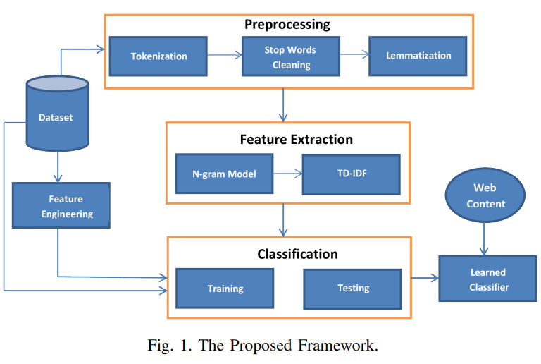

Slide 8
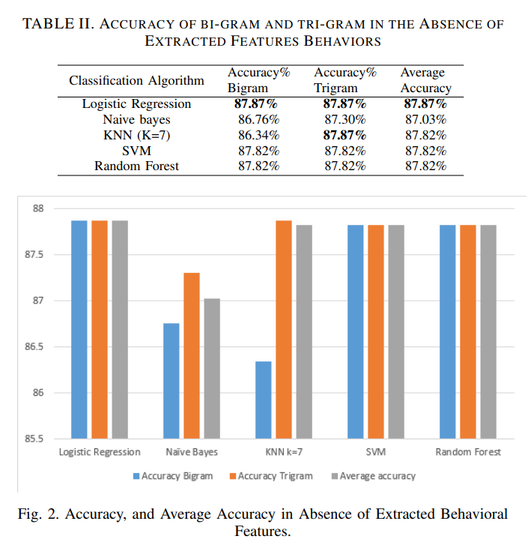
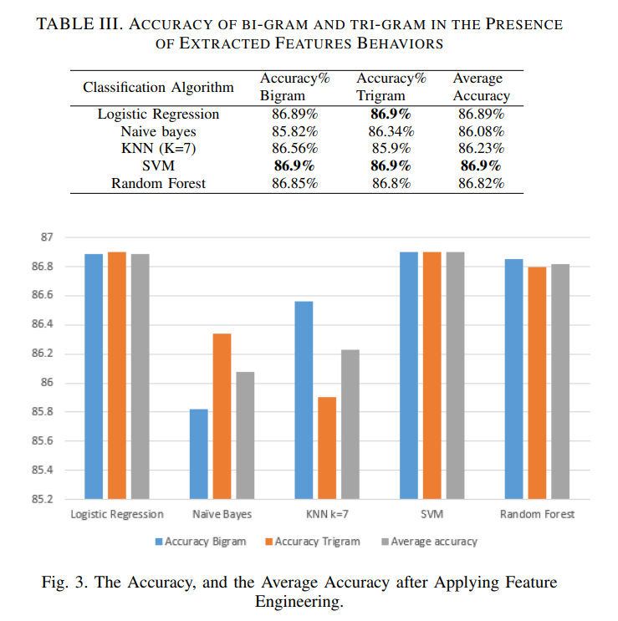
Experimental Results I:

Slide 9
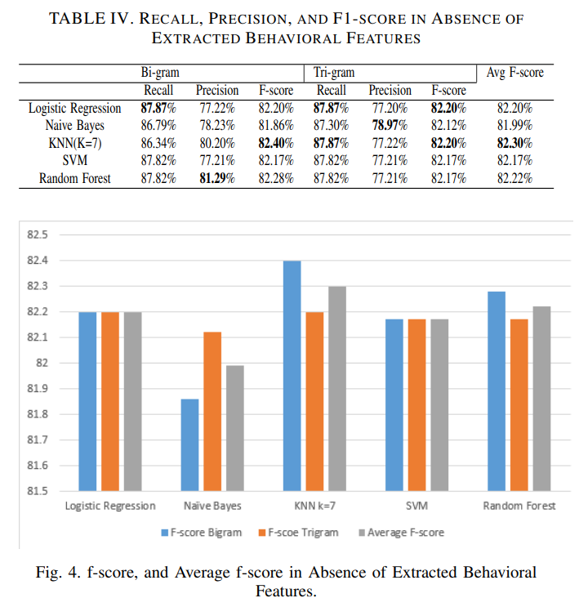
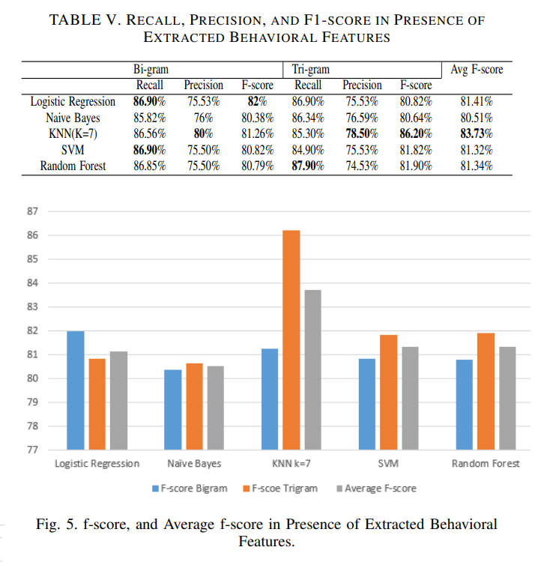
Experimental Results II:

Slide 10
Conclusion
&
Future Work
This paper highlights the importance of detecting fake reviews online as they have a strong impact on consumer decisions.
In the proposed approach, the features of the reviews and the behavioral features of the reviewers are tested over different classifiers and language models. The results reveal that KNN (where K=7) classifier outperforms the rest of classifiers, and that behavioural data enhances the performance.
Future work may consider including other behavioral features such as timing, frequency or even positive or negative tone of reviews. The implementation of more behavioural features is expected to greatly improve the performance of the presented fake reviews detection approach.

